Slide 1
Heat Hack 2022: Climate Change and Energy Consumption
By: Sykes Squad (Robert Jones and Caleb Shuda)

Slide 2
Research Question: Heat Related Illness
How can we prevent heat related issues such as heat stroke and heat exhaustion as yearly temperatures rise due to Climate Change?
According to the CDC, not using air conditioning during summer months can lead to increased temperatures in buildings as heat gets trapped inside, increasing the risk of heat related illness or death.
The CDC also estimates that last year nearly 1000 americans died due to heat related illnesses, and around 60,000 were hospitalized with non-fatal heat related illnesses.
In these cases the elderly were several times more likely to be hospitalized as well as pass due to heat related illness.

Slide 3
Research Question: Energy Budgeting
How can we incentivize citizens to not budget their energy bills by turning down their Air Conditioners?
Those living in lower income brackets may be more likely to budget their energy uses to save money
Rising energy bills due to global politics and rising temperatures may cause increased budgeting and risk of exposure to extreme heat or cold.
As total expenses across income brackets remain fairly static, the percent of household income that is spent on electricity drastically increases as household income falls.

Slide 4
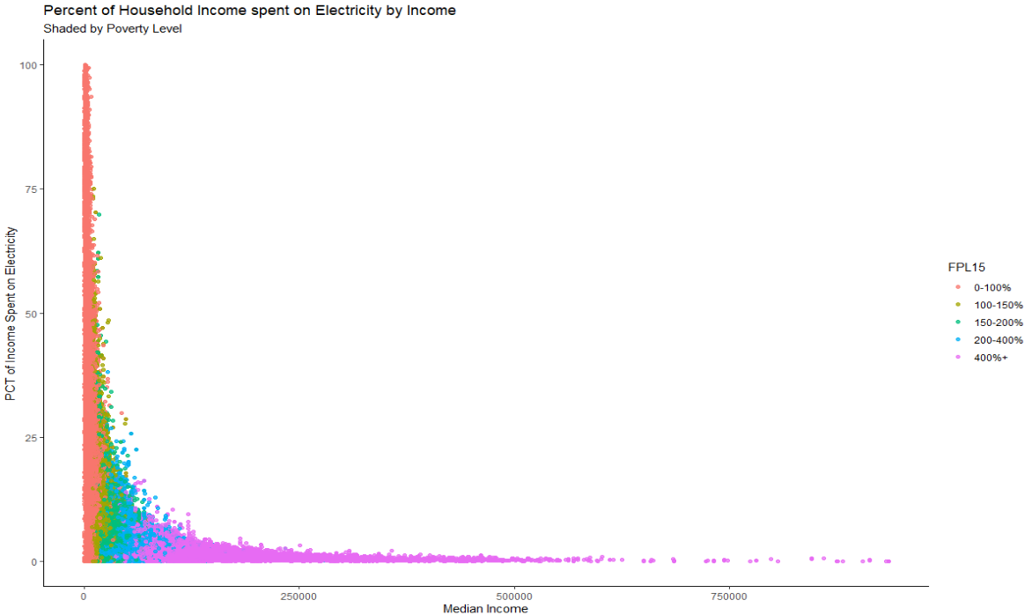

Slide 5
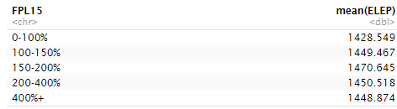
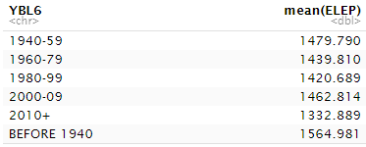
Methods
Due to time and data restraints, we chose to focus on researching how North Carolinians consume Energy at home. We utilized the Low-Income Energy Affordability Data (LEAD) to compare households based on income bracket (FPL15), building type (BLD), year the building was built (YBL6), Household Income (HINCP), and ownership (TEN).

Slide 6
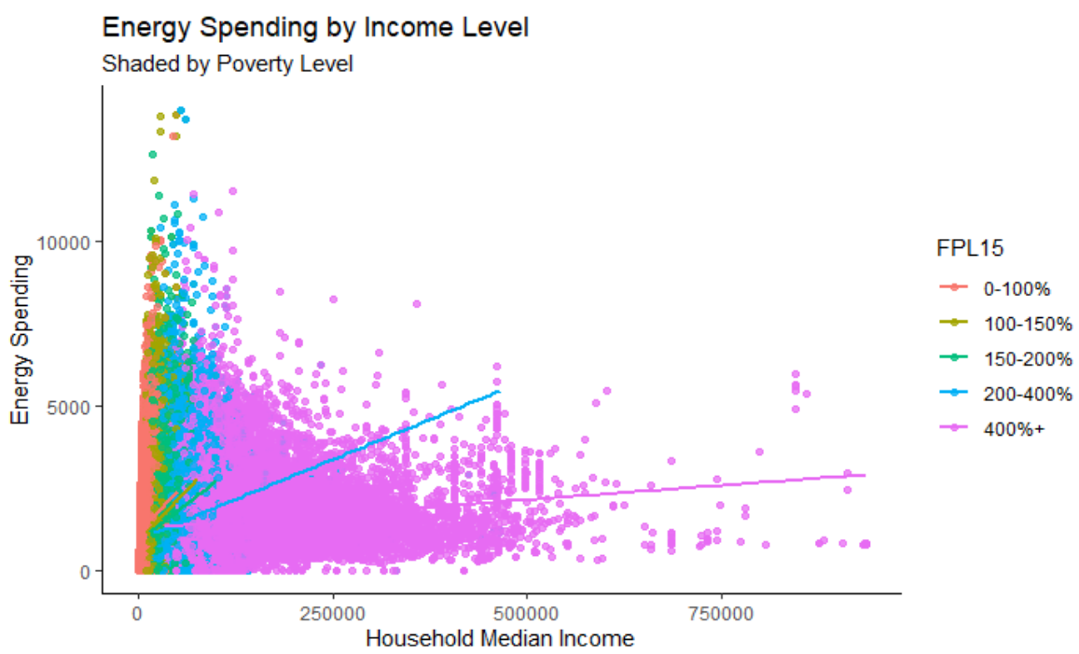

Slide 7
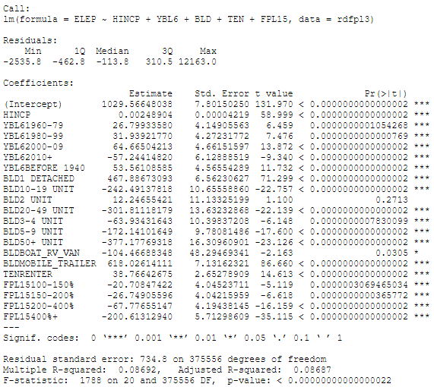
Regression: Energy Expense per Year
Intercept: 1940 -1959, Attached home, Owner living 0-100% of the Federal Poverty Level.
As % above FPL increases, yearly expenditure on energy decreases.
Mobile homes are the most inefficient dwellings for citizens.
When the building parameter changes to that of Mobile Trailers, energy expenditure increases by $618.03 per year.
Buildings with more that 5 units are the most efficient dwellings for citizens.
When building parameter changes to that of 50+ units, energy expenditure decreases by $377.18 per year.

Slide 8
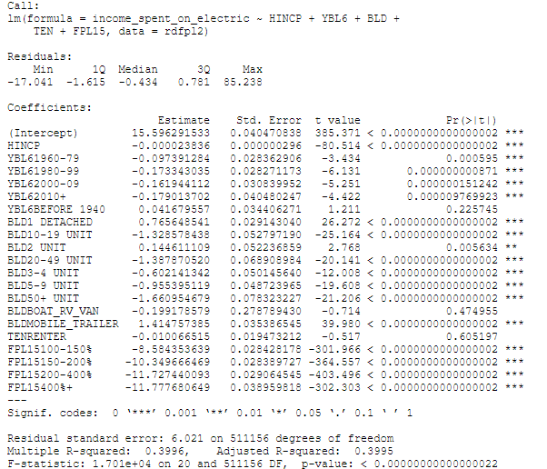
Regression: Percent of Income Spent On Electricity
Intercept: 1940 -1959, Attached home, Owner living 0-100% of the Federal Poverty Level.
Data proves that as income increases, percentage of income spent on electricity decreases.
Mobile Homes, Detached Homes, and 2BLD Units seem to increase the Percent of Income Spent on Electricity for families.
Buildings with more than 10 units see some of the largest decreases in Percent of Income Spent on Electricity.
When building parameter changes to that of 50+ units, income spent on electricity decrease by 1.66 percentage points.

Slide 9
Recommendations: Weatherstripping and Insulation
Subsidies should be provided to owners of less insulated homes, like mobile homes, to incentivize them to improve their energy efficiency.
Our data shows that owners and renters of detached and mobile homes spend more per month on their electricity bill than their counterparts.
9 out of 10 homes in the United States are under insulated, according to Energy Star.
Mobile and older homes are particularly at risk for this.
The EPA estimates that homeowners can save an average of 11% on total energy costs by air sealing and adding insulation to their homes.
Impact: Homeowners will save hundreds of dollars a year on their energy bill, lower their risk of exposure to extreme weather, and help combat global Climate Change.

Slide 10
Recommendations: Energy Subsidies
If someone qualifies for medicare/medicaid, NC will subsidize energy bill by directly paying duke energy for usage during summer months
When someone signs up for medicare/medicaid, they are automatically signed up for energy subsidies.
If they are approved for medicare/medicaid, they will be automatically approved for energy subsidies.
NC will pay entirety of energy bill for qualifying households from April 1st through September 31st
CDC Data show that 94% of Heat Related Fatalities occur between May and September

Slide 11
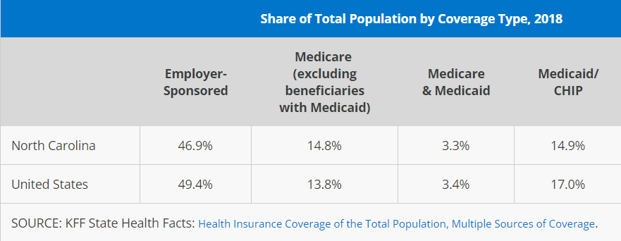
Energy Subsidies Continued
33% of NC is currently covered by Medicare or Medicaid.
The average NC household spends 150$ a month on their electricity bill.
With 4 million household in NC, this would total at $200 million.
For feasibility, adding additional qualifiers to this plan could reduce its cost, such as income brackets to determine how much of the energy bill is subsidised, or cutting the amount subsidised in general.

Slide 12
Recommendations: Multi-Family Apartments
If consumers want to be more responsible global citizens, they should live in apartment buildings and condos.
Our data shows that multi-family apartments are the most energy efficient dwellings in North Carolina.
Buildings with more than 5 units save hundreds of dollars a year on energy expenditures.
Less energy necessary to heat and cool a dwelling means less CO2 emitted into the atmosphere.
Because of greater energy efficient, citizens will also spend less of a percentage of their income on energy expenses.
Impact: Transitioning households to large dwellings could protect vulnerable populations, lower energy costs, and reduce emissions caused by our energy grid’s current dependency on fossil fuels.

Slide 13
Works Cited
https://www.energystar.gov/campaign/seal_insulate/why_seal_and_insulate
https://www.cdc.gov/pictureofamerica/pdfs/picture_of_america_heat-related_illness.pdf
https://www.epa.gov/climate-indicators/climate-change-indicators-heat-related-deaths
https://www.climate.gov/news-features/understanding-climate/climate-change-global-temperature#:~:text=According%20to%20NOAA's%202020%20Annual,more%20than%20twice%20that%20rate.

